Slide 1


Custom network scanner
Ziyad al gebri, tymon schuringa

Slide 2
assessment
Build network scanner
Why is it useful?

Slide 3
requirements
➢ Host Discovery
➢ Port Scanning
➢ Application & Version Detection
➢ OS Detection

Slide 4
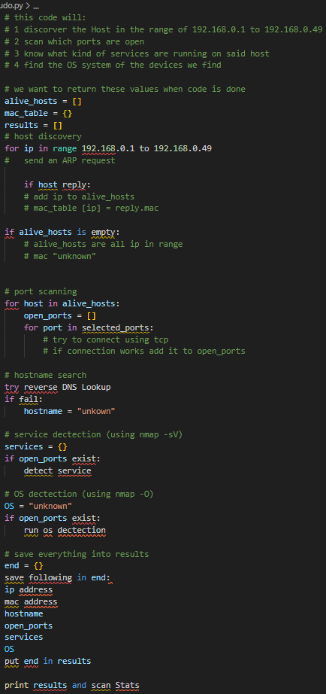
progression
Code design: which functions do we need?
Pseudo code

Slide 5
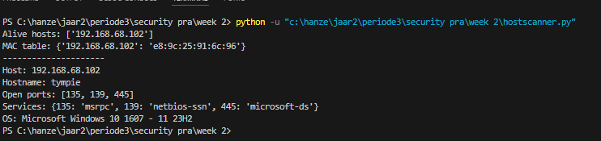
Results tested from home:

Slide 6
Improvements
Use colorama for improvement of readability
Scan a multitude of networks
write proper docstrings
Progress reports during the scan
Allow user to control scan options in command line. (Including scanning different subnets)
Write the rapport

Slide 7
conclusion
There has been solid progress on the design
We build a strong foundation of the functionality
Clear vison for completion of assessment

